Slide 1
Week 5 & 6
DSC 640
Abed Tabbalat

Slide 2
Python

Slide 3

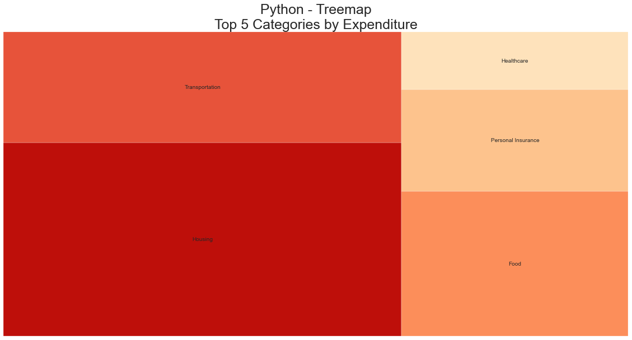
Python – Tree Map

Slide 4
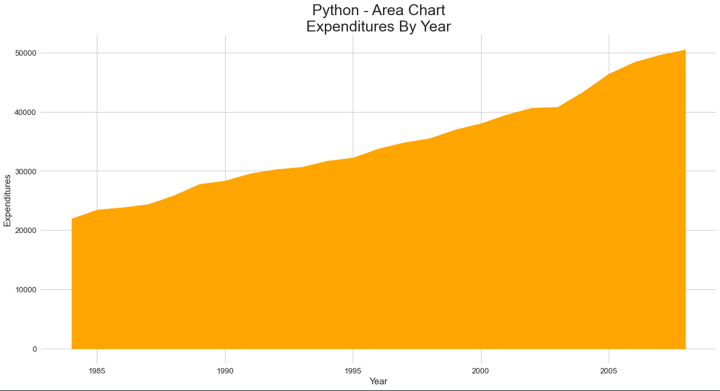
Python – Area Chart

Slide 5
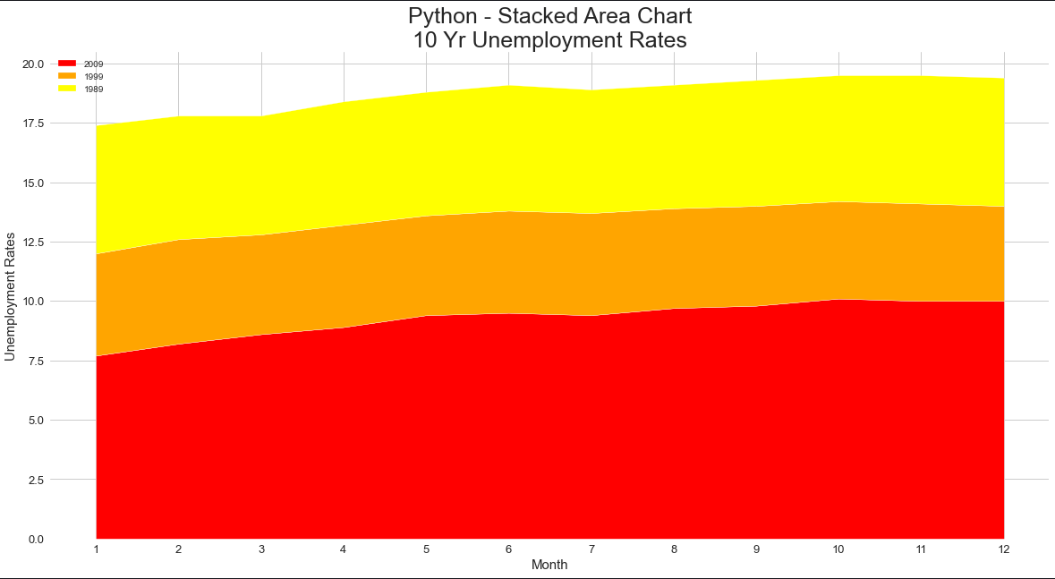
Python – Stacked Area Chart

Slide 6
R

Slide 7
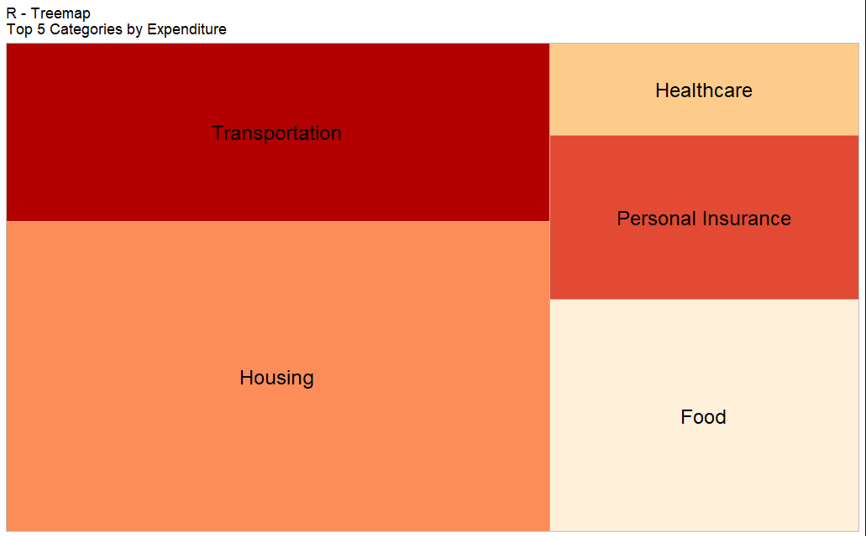
R – Tree Map

Slide 8
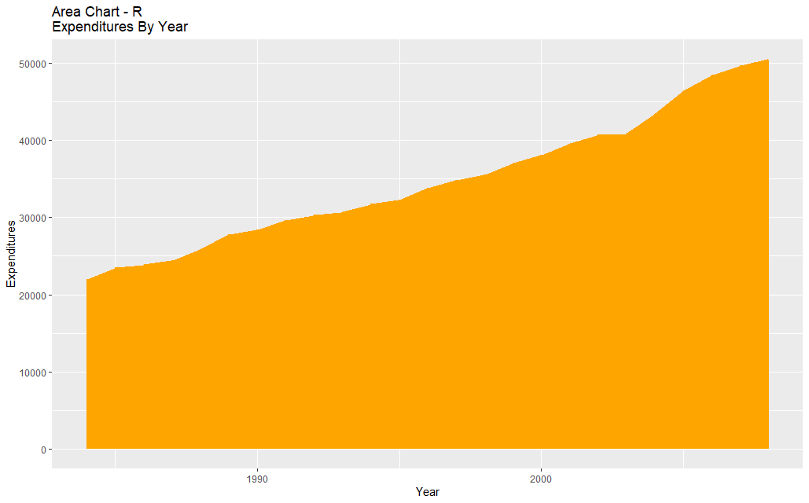
r – Area Chart

Slide 9
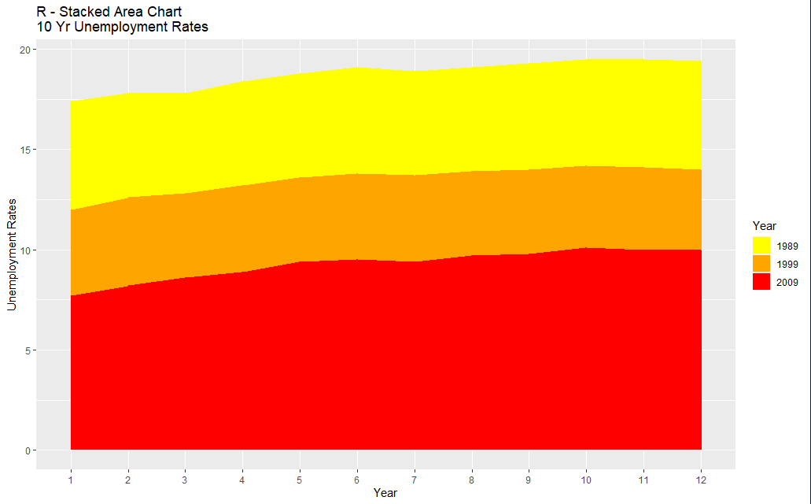
r – stacked Area Chart

Slide 10
Tableau

Slide 11
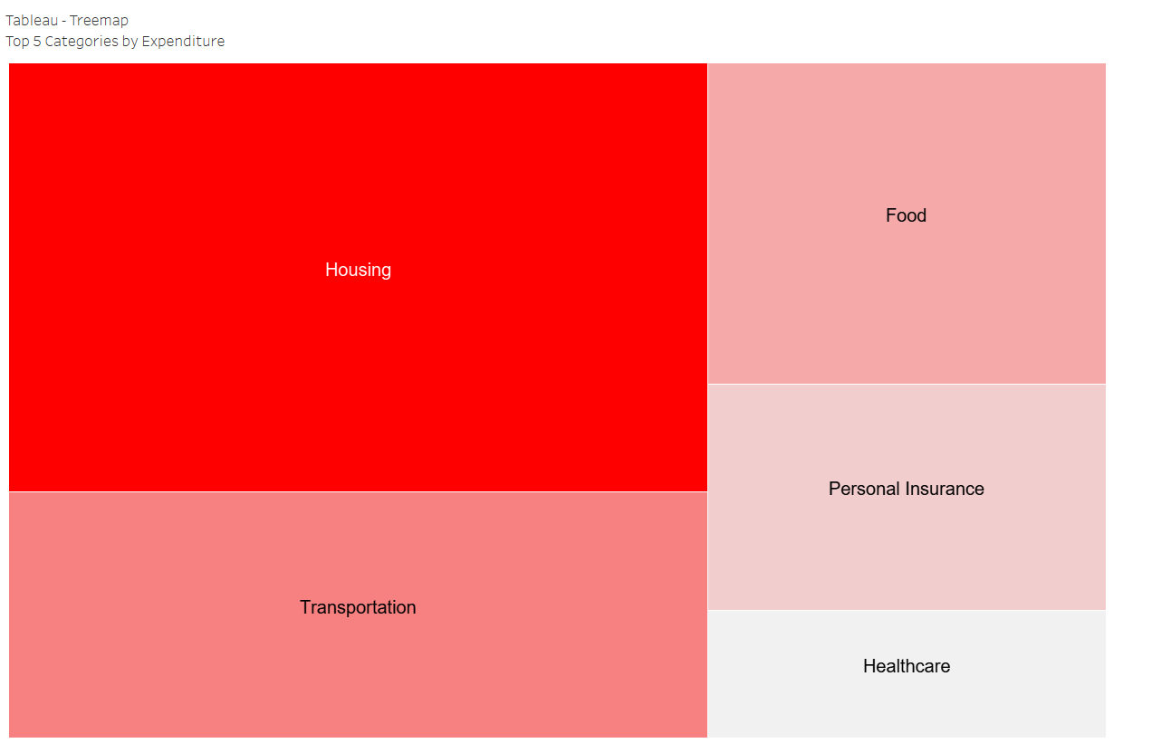
Tableau – Tree Map

Slide 12
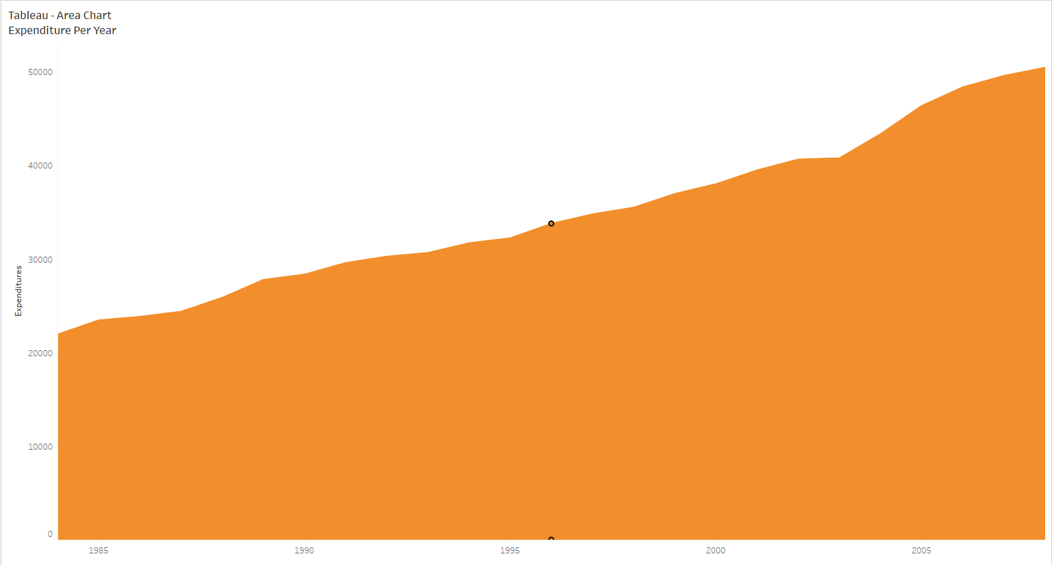
Tableau – Area Chart

Slide 13
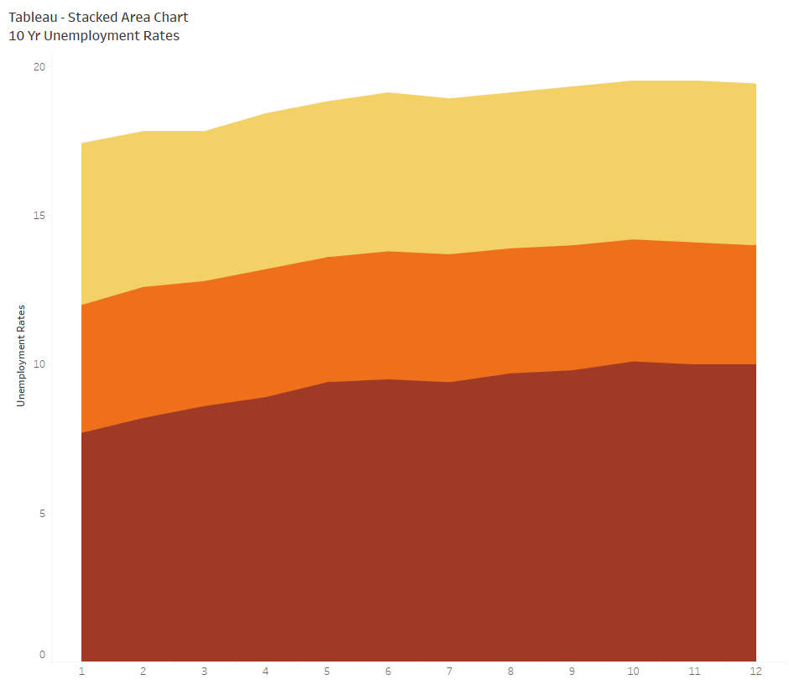
Tableau – Stacked Area Chart

